Slide 1
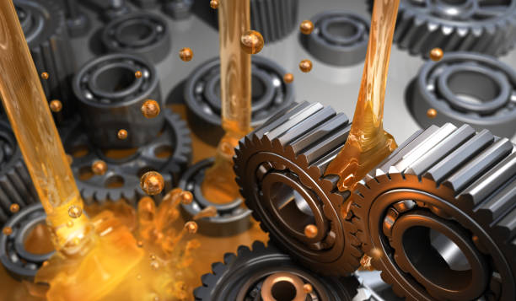


Report on Lubricants
INTRODUCTION
ANALYSIS OF LUBRICANTS
INDIA LUBRICANT MARKET ANALYSIS
INDUSTRY OVERVIEW
CONCLUSION

Slide 2

INTRODUCTION A lubricant (sometimes shortened to lube) is a substance that helps to reduce friction between surfaces in mutual contact, which ultimately reduces the heat generated when the surfaces move. It may also have the function of transmitting forces, transporting foreign particles, or heating or cooling the surfaces.

Slide 3
ANALYSIS OF LUBRICANTS 1. Advanced Technology: With advancements in technology, industries are likely to demand more specialized and high-performance lubricants to meet the requirements of modern machinery and equipment. 2. Environmental Considerations: There is a growing emphasis on environmentally friendly lubricants to reduce the ecological impact. Bio-based and eco-friendly lubricants are likely to gain popularity.

Slide 4
3. Synthetic Lubricants: The use of synthetic lubricants is expected to rise due to their superior performance in extreme conditions, longer lifespan, and improved efficiency. 4. Smart Lubrication: The integration of IoT (Internet of Things) in machinery and equipment is likely to lead to smart lubrication systems, allowing for real-time monitoring and optimization of lubricant usage.

Slide 5
5. Globalization: Globalization of industries may impact the types of lubricants used, with standardization and compatibility becoming crucial for multinational operations. 6. Electric Vehicles: With the rise of electric vehicles, there might be shifts in lubricant demand. While traditional engine oils will still be needed, there could be a rise in demand for specialized lubricants for electric vehicle components.

Slide 6
7. Maintenance Practices: Predictive maintenance practices, facilitated by data analytics and sensors, may influence lubricant usage patterns, ensuring timely replacements and reducing down time. It's important to note that these trends are subject to various factors and may vary across different industries and regions. Keeping abreast of technological developments, industry trends, and environmental regulations will be crucial for understanding the future scope of lubricants.

Slide 7
India Lubricants Market Analysis The India Lubricants Market stood at 2.44 billion litres in 2021 and is projected to register a CAGR of 5.24% to reach 3.15 billion litres in 2026. 1. Largest Segment by End-user Industry - Automotive : Due to the higher volume of engine & gear oil used in motor vehicles compared to any other industrial application, automotive was the largest end user among all categories. 2. Fastest Segment by End-user Industry - Automotive : Automotive is likely to be the fastest-growing end-use segment of lubricants in India due to consumers' rising purchasing power resulting in increasing vehicle ownership.

Slide 8
3. Largest Segment by Product Type - Engine Oils : Engine oil is the highest consumed product category in India owing to the enormous engine size of cars, motorcycles, trucks & buses and their high oil changing frequencies. 4. Fastest Segment by Product Type - Engine Oils : Engine oil consumption in India is likely to grow at a faster rate than other product types due to the growing presence of gasoline- and diesel-run vehicles in the country.

Slide 9
INDUSTRY OVERVIEW The India lubricants market size was USD 256.89 Billion in 2022 and is likely to reach USD 315.53 in 2026 and USD 406.79 Billion by 2031, expanding at a CAGR (Compound annual growth rate) of 5.24% during 2023–2031.Growth of the market is attributed to rapid urbanization, increasing overall efficiency & productivity for enterprises, and increasing production of two-wheeler vehicles. In the year 2022-23, Indian lubricants industry was impacted by the global economic slowdown, fluctuating base oil prices, increase in raw material and packaging costs and dollar exchange prices, creating stress on the entire value chain. The Lubes Business has overcome these challenges by reorganizing and rebuilding itself during the year.

Slide 10
CONCLUSION There are basically four major points I think a company should focus on 1. Educate Customers: Highlight the benefits of using high-quality lubricants, including improved machinery performance, reduced maintenance costs, and extended equipment lifespan. 2. Customized Solutions: Understand specific industry needs and offer tailor-made lubrication solutions to meet the unique requirements of clients.

Slide 11

3. Digital Marketing Strategies: Utilize online platforms for targeted marketing, reaching potential customers and creating awareness about your lubricant products. 4. Partnerships and Collaborations: Form partnerships with equipment manufacturers or industrial businesses to integrate your lubricants into their product lines, expanding your market reach. Remember, the lubricants industry is evolving, and staying informed about technological advancements, market demands, and environmental considerations is crucial for sustained success.

Slide 12
THANK YOU

